Slide 1


Online Recruitment System
Submitted as
Forth Year 6 Months Training project
towards completion of
B.Tech Computer Science Software Engineering
Project By:
Mr. Sushil Singh
Project Supervisor:
Mr. Manoj Jain Sir

Slide 2
Modules
Module in this project:
Administrator
Jobseekers
Company
Brief description on the modules:
1. Administrator: Administrator has the full authority over the website. He can view all the registered users and have the power to delete them. He can edit the web pages and update them. He can view all the company details also.
2. Jobseeker: A jobseeker can register himself. After registration, he will be directed to his homepage. Here he can update his profile, change password and see the examination details and all.
3. Company: A company can register itself, conduct online examination, approve or disapprove candidates attending examination and provides results about the selected candidates.

Slide 3
Project Summary
This project Online Recruitment System is an online website in which jobseekers can register themselves online and apply for job and attend the exam.
Such websites have facilities where prospective candidates can upload their CV’s and apply for jobs suited to them.
The application uses a MS Access database to store its records which has necessary advantages over the file based system.

Slide 4
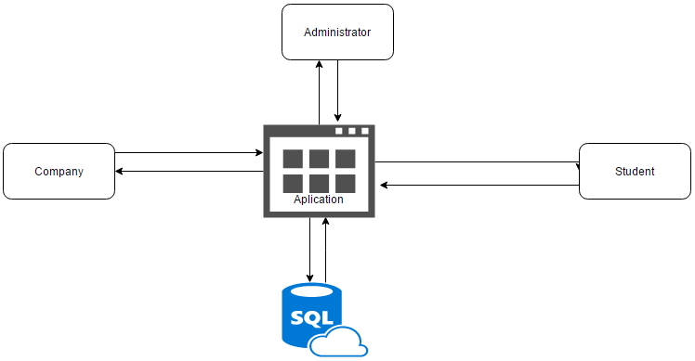
Context Diagram.

Slide 5
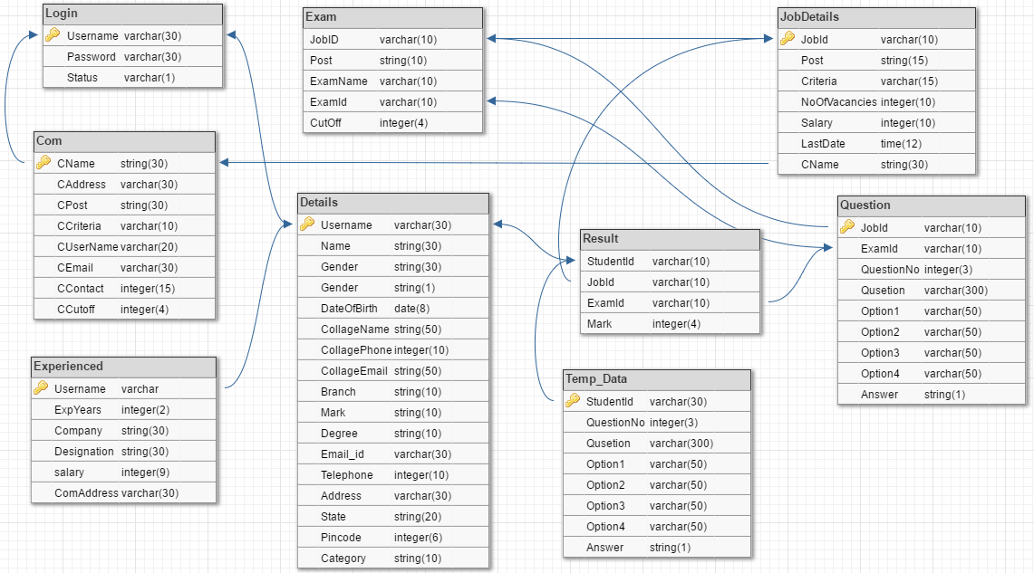

Slide 6
System Requirement
HARDWARE REQUIRED
Minimum 500MB Hard Disk
Windows XP/Vista/7/8/10/Mac/Linux
Minimum1GB Ram
Minimum Core 2 Duo Processor
Any Graphics Card.
SOFTWARE REQUIRED
1. IDE
Eclipse
2. SERVER
Apache and Tomcat
3. DATABASE
Microsoft Access, MySQL
4. JDK installed version 1.7
5. Java virtual machine

Slide 7
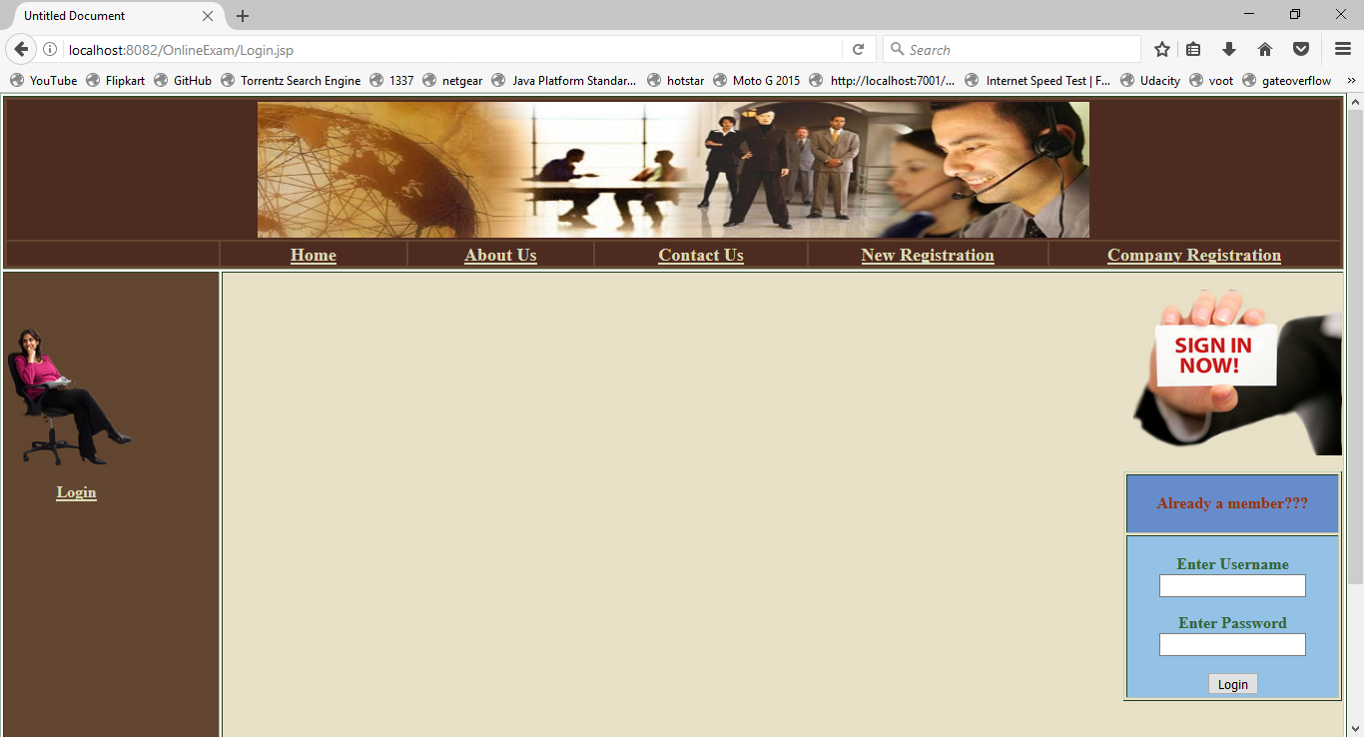
Login Page

Slide 8
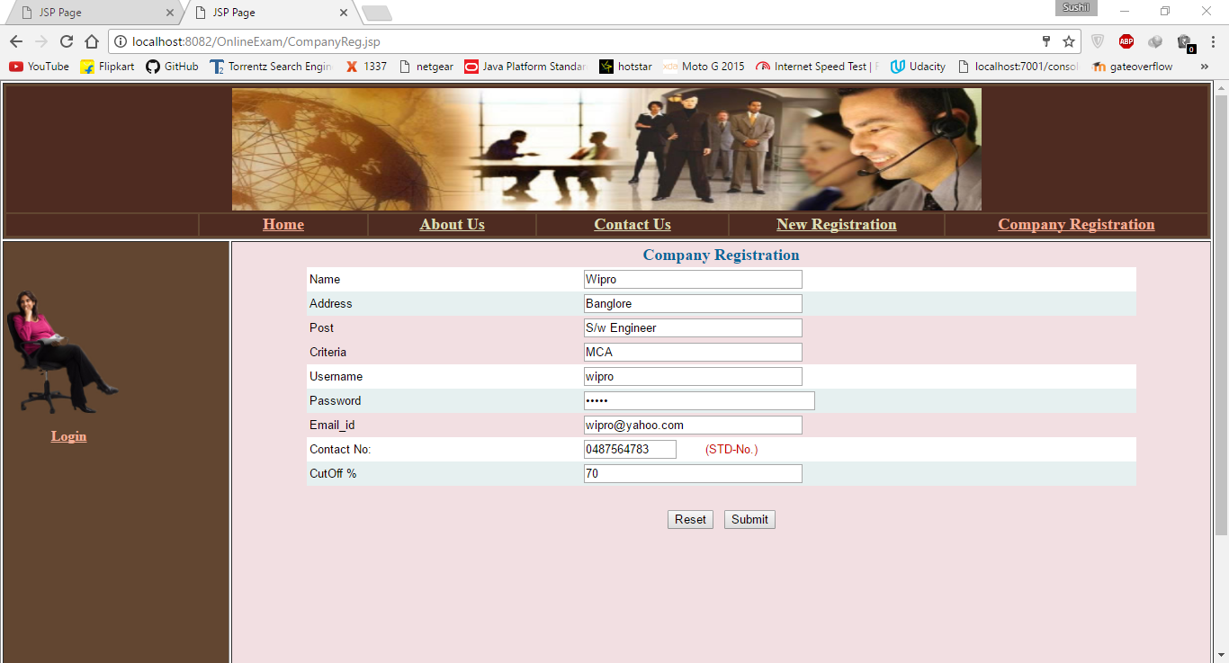
Company Registration

Slide 9
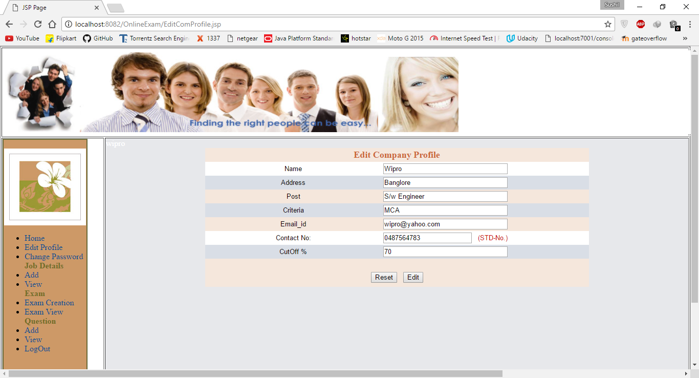
Company Edit Profile

Slide 10
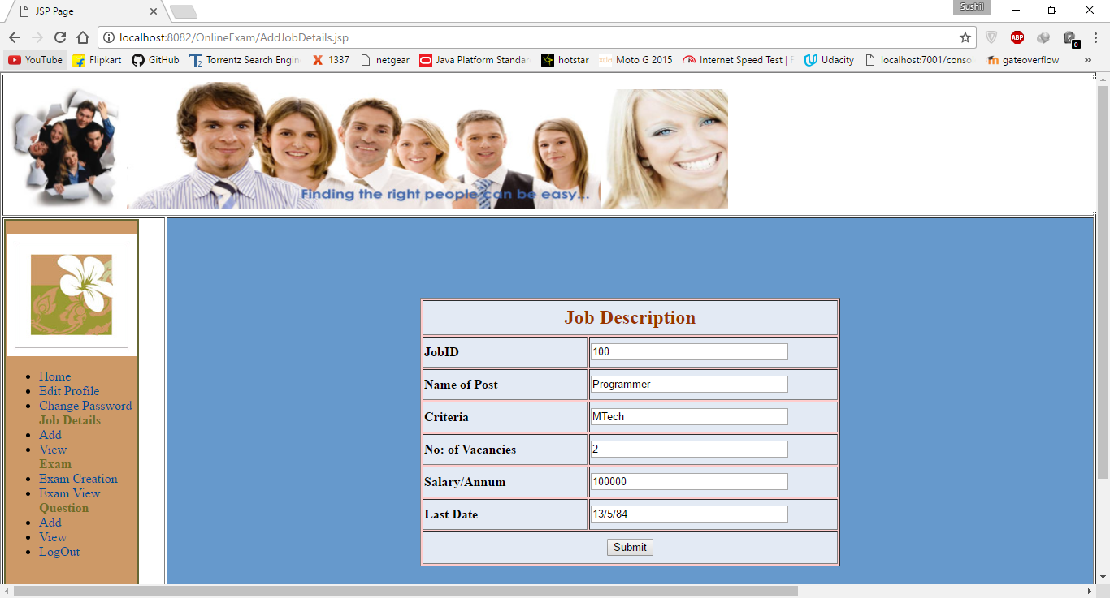
Add Job

Slide 11
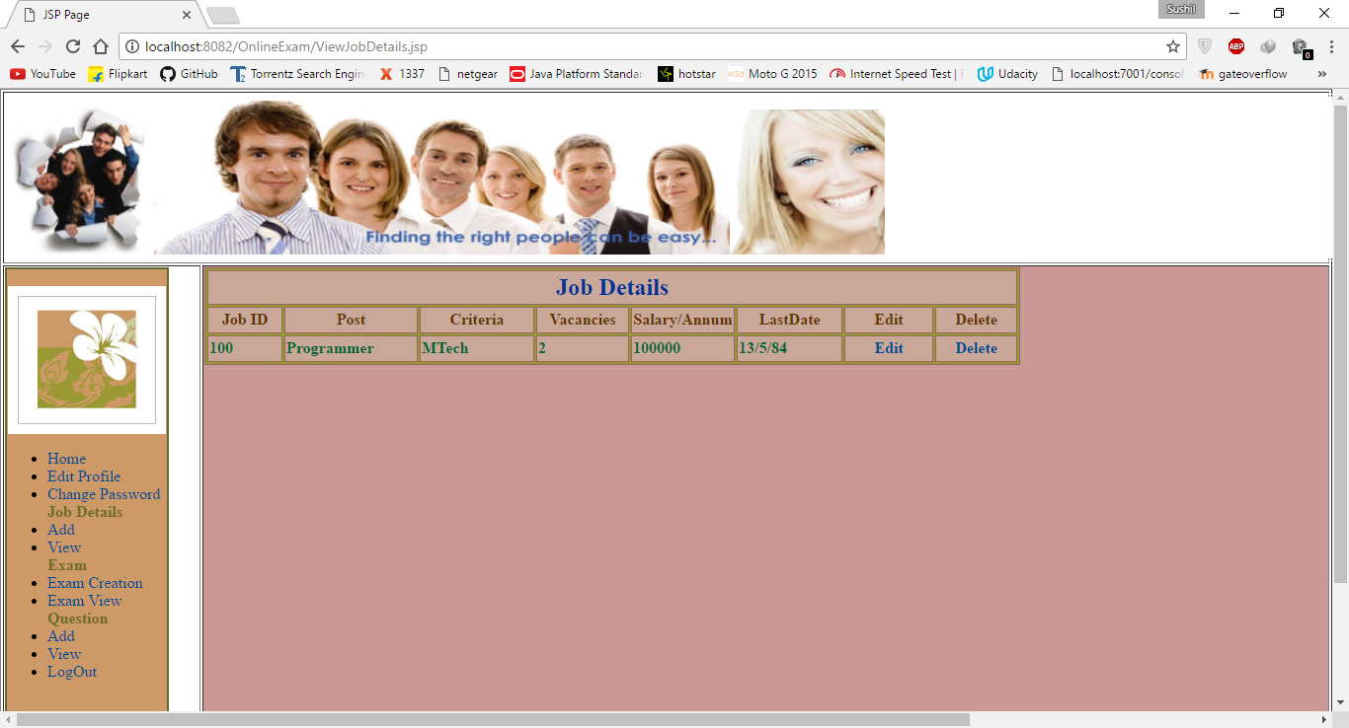
View Job

Slide 12
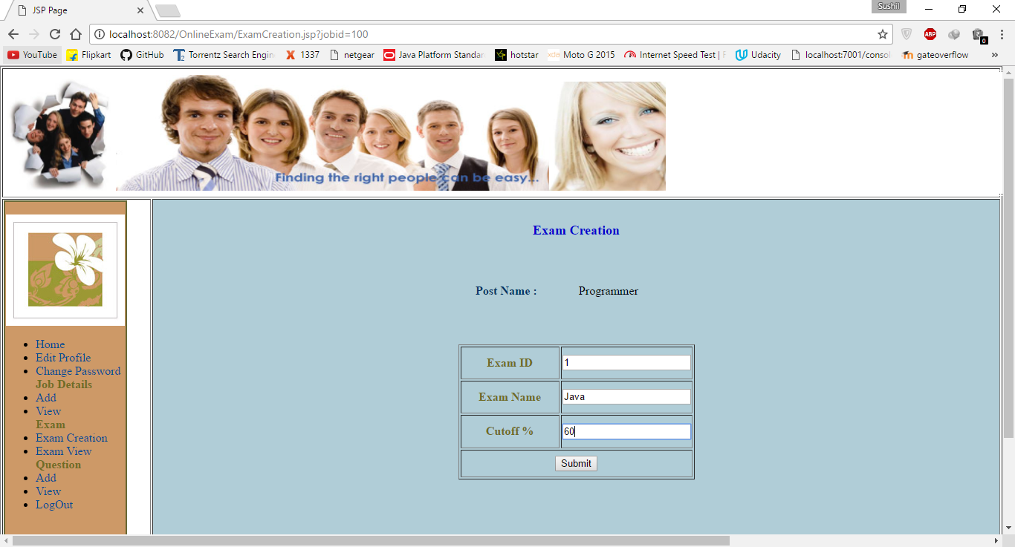
Add Exam

Slide 13
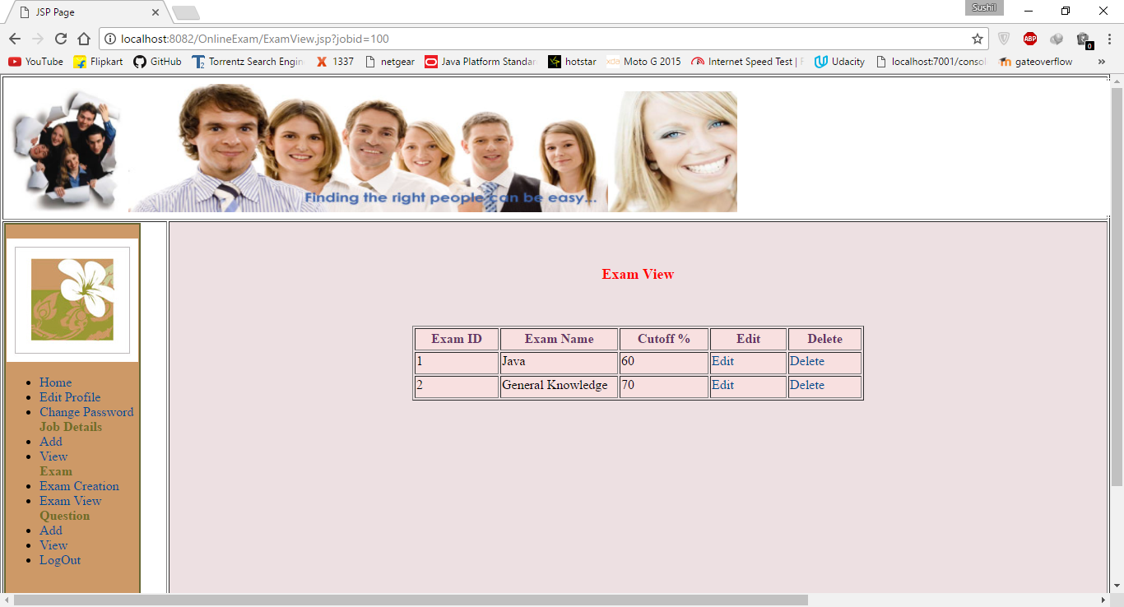
View Exam

Slide 14
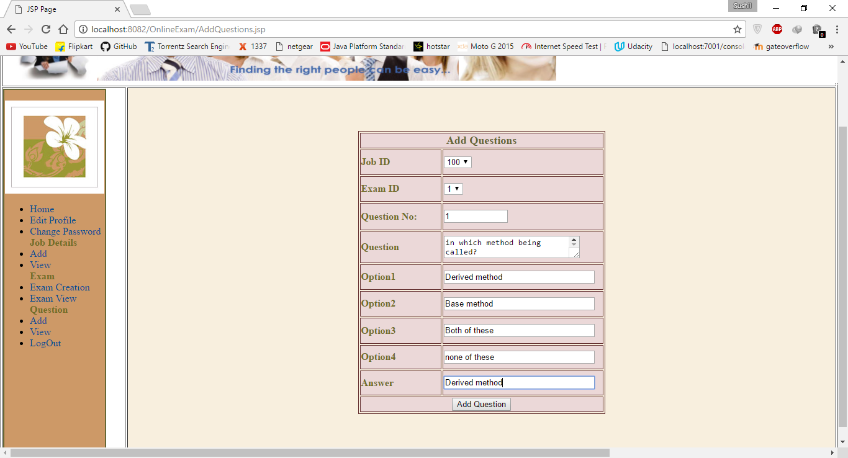
Add Question

Slide 15
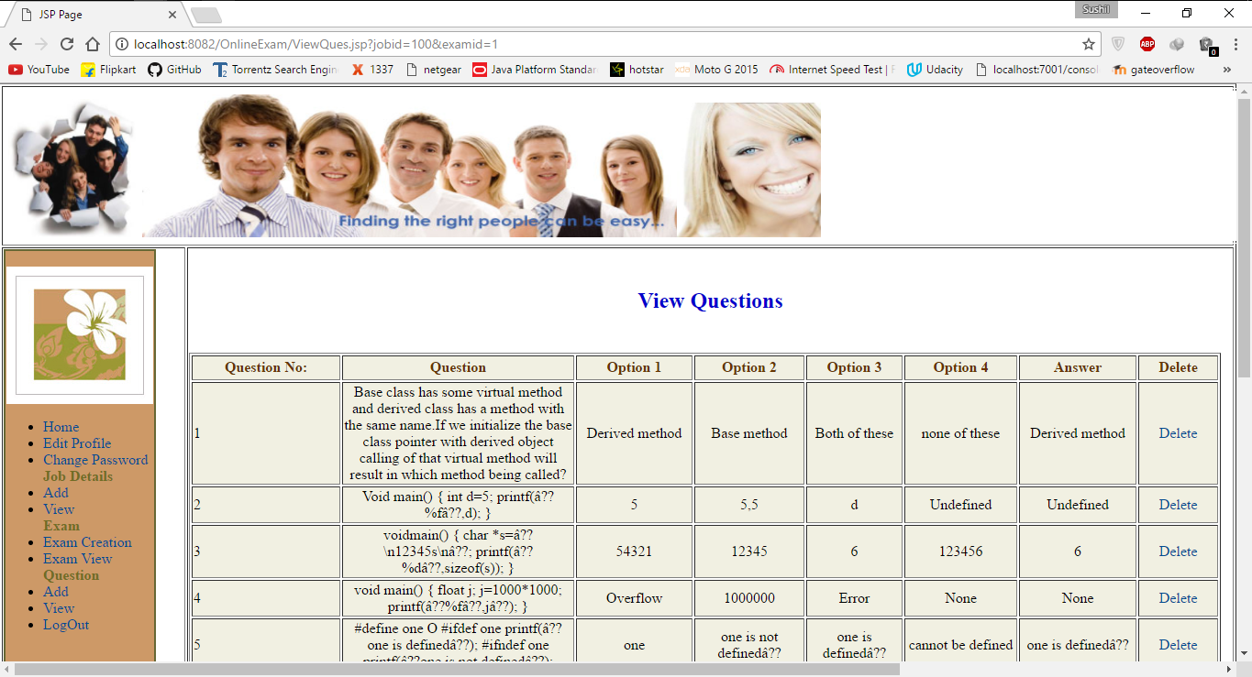
View Question

Slide 16
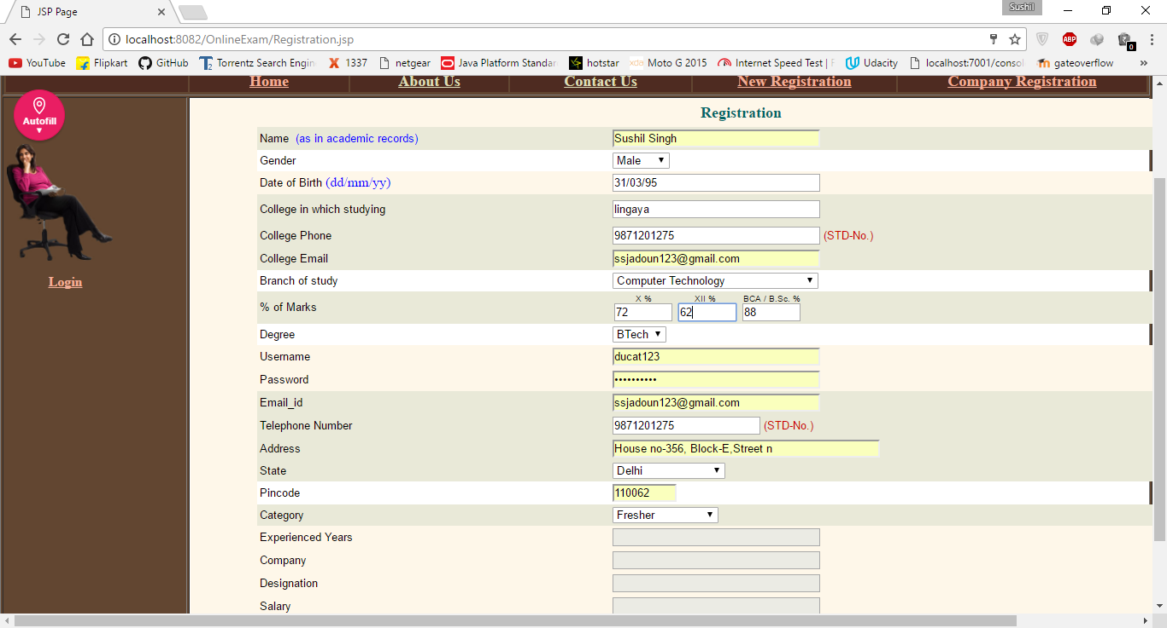
Student Registration

Slide 17
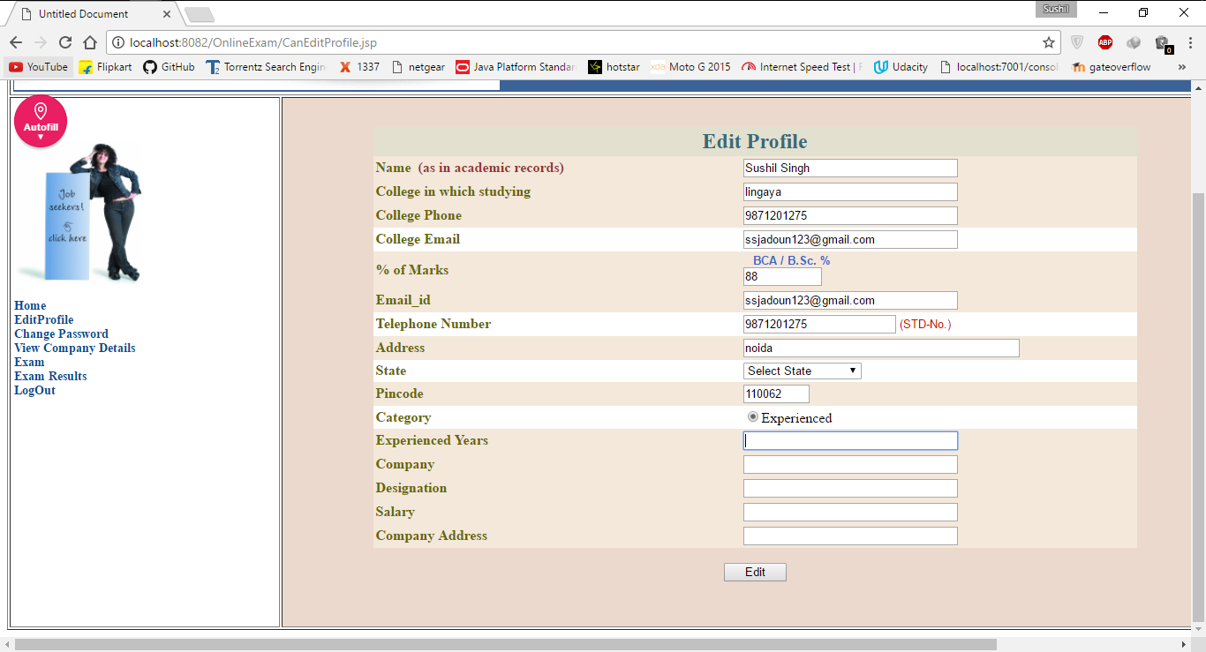
Edit Student

Slide 18
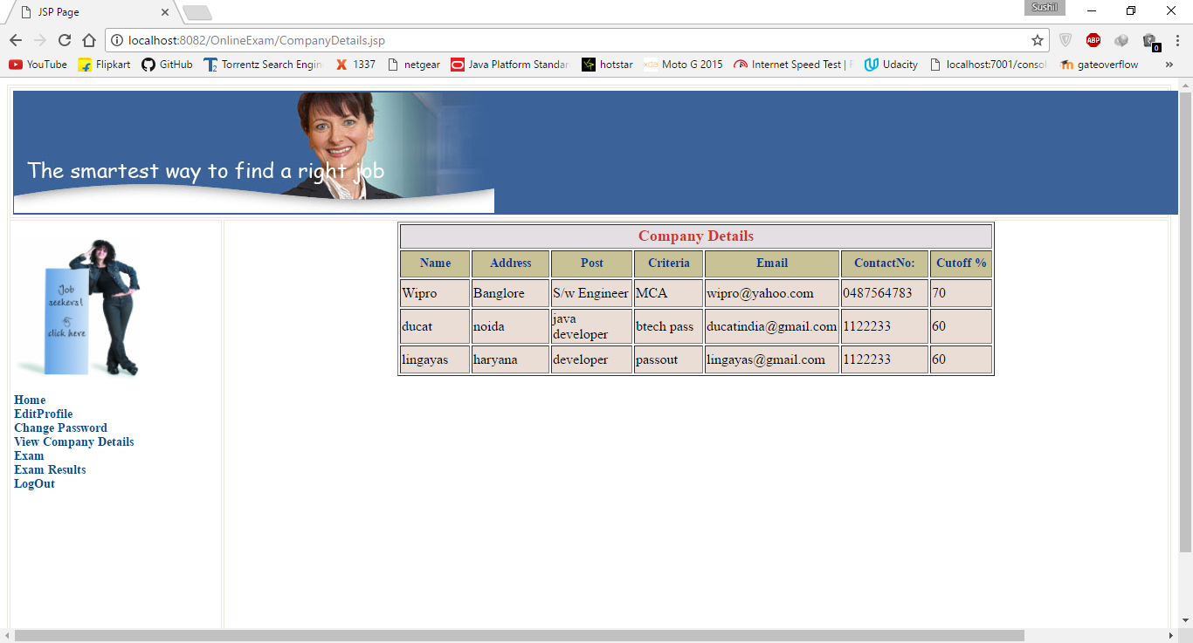
View Companies

Slide 19
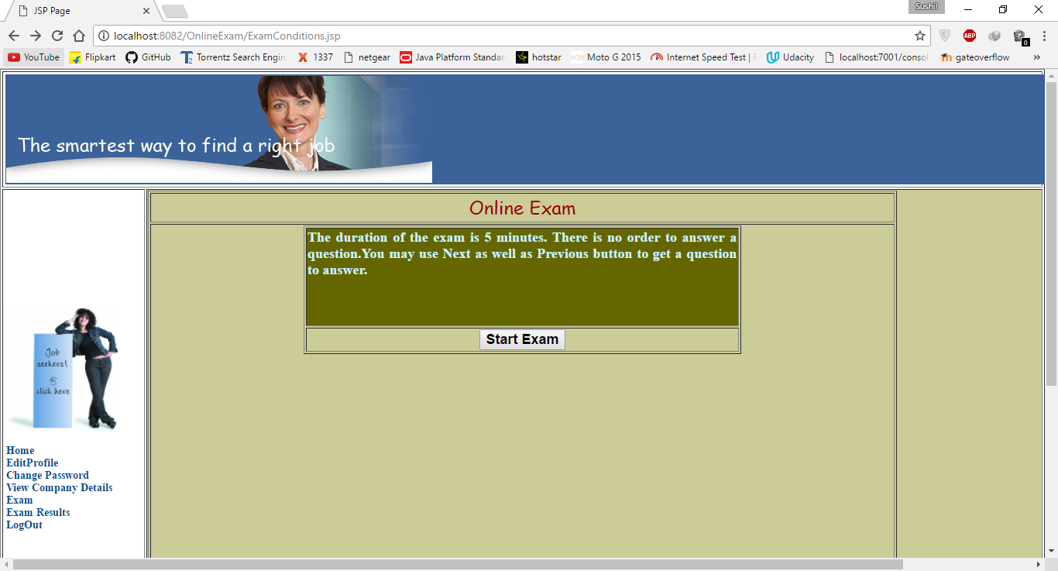
Exam step1

Slide 20
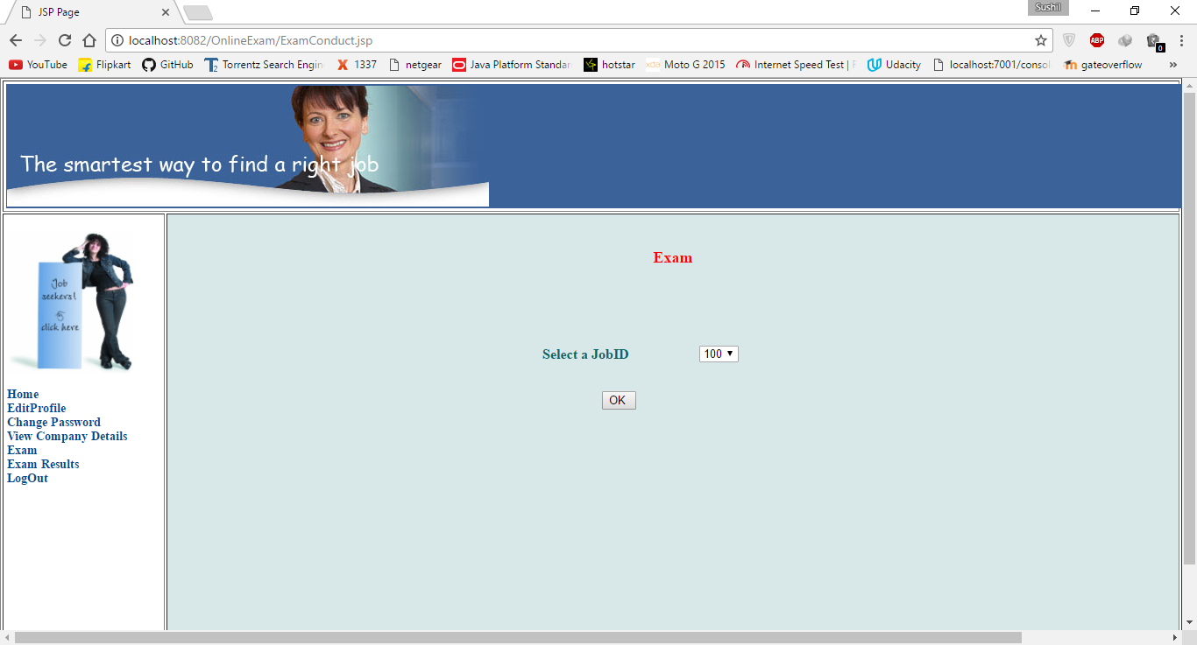
Exam step2

Slide 21

Exam step3

Slide 22
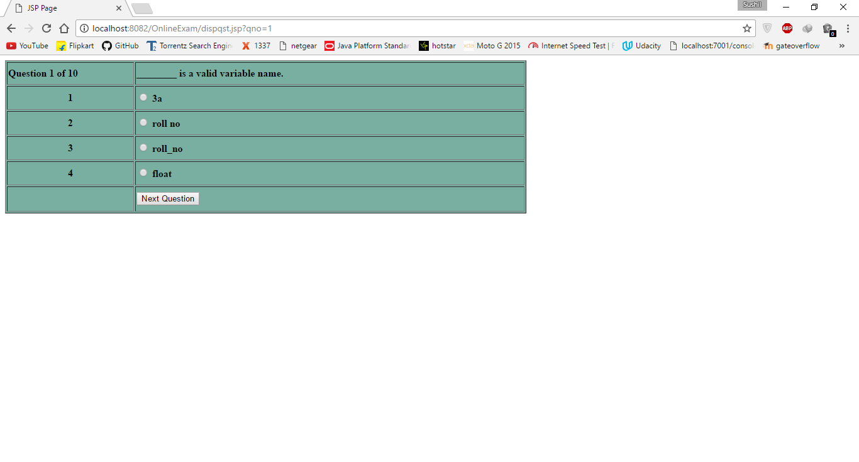
Exam step4

Slide 23
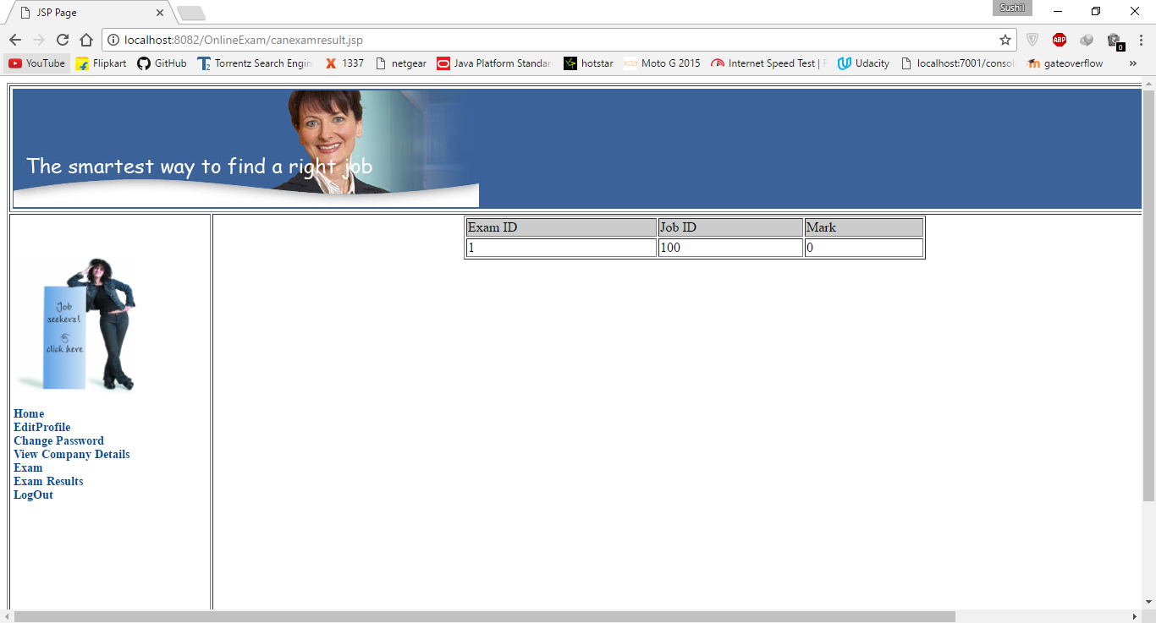
Exam Result

Slide 24
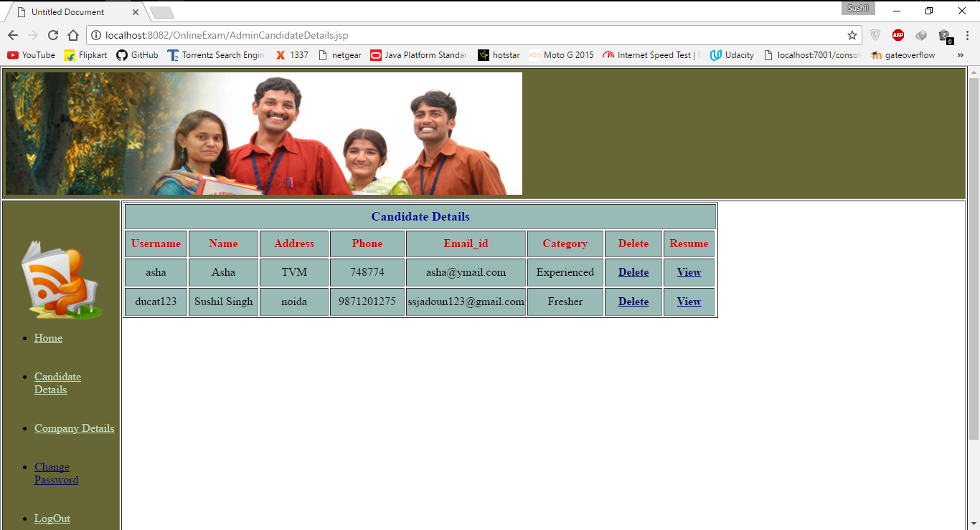
Admin Managing Student

Slide 25
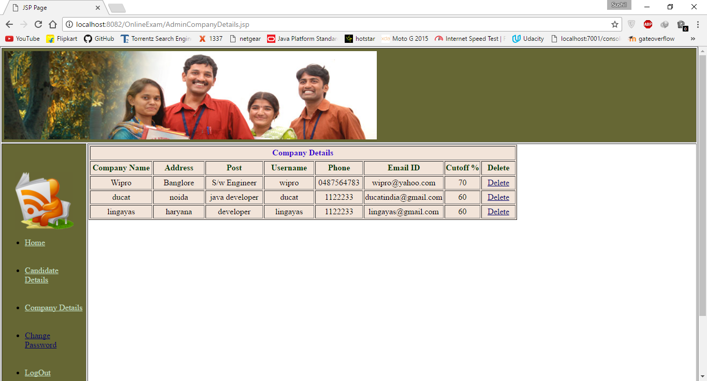
Admin Managing Company

